Slide 1
Digital Portfolio
STUDENT NAME : Lipnee.R
REGISTER NO : 222407894
NMID : autunm1455ds242734
DEPARTMENT : B.Sc Computer Science with Data Science
COLLEGE : Tagore college of arts and science
UNIVERSITY : University of Madras

Slide 2
PROJECT TITLE
fabric
Linen
Cotton
Silk
Denim
Wool
Nylon
Satin
Velvet
rayon

Slide 3


AGENDA
Problem Statement
Project Overview
End Users
Tools and Technologies
Portfolio design and Layout
Features and Functionality
Results and Screenshots
Conclusion
Github Link
3/21/2024 Annual Review

Slide 4

PROBLEM STATEMENT
In the modern textile and fashion industry, managing and showcasing fabric collections effectively is essential for both designers and customers. However, traditional methods of fabric showcasing are often physical, time-consuming, and lack accessibility. There is a need for a digital portfolio system where fabrics can be displayed systematically with details such as texture, material, color, price, and availability.
The goal of this project is to develop a fabric portfolio web application that provides a digital catalog of fabric samples, helping designers, manufacturers, and clients browse and manage fabric information efficiently.

Slide 5

PROJECT OVERVIEW
The fabric portfolio is a web-based application that allows users to upload, manage, and showcase fabric samples digitally. The system provides a user-friendly interface where each fabric entry can have attributes like fabric name, type, composition, texture, image, and price.
This platform is designed to digitize the fabric cataloging process, making it accessible to clients, designers, and stakeholders from anywhere in the world.

Slide 6

WHO ARE THE END USERS?
Fashion Designers – to keep track of their fabric samples and inspiration.
Textile Manufacturers – to showcase their product catalog to potential buyers.
Retailers and Wholesalers – to manage fabric listings and stock availability.
Buyers and Clients – to browse and filter fabrics based on need or style.

Slide 7

TOOLS AND TECHINIQUES
HTML : Structure( Pages, sections)
CSS : Styling( Colors, layout, responsiveness).
JAVA SCRIPT : Interactivity(navigation menu, animations, from validation).
Mention code editor(Vs code) or CODEPEN and hosting platform(GitHub pages).

Slide 8
.
PORTFOLIO DESIGN AND LAYOUT
Creating a fabric portfolio design and layout involves organizing fabric samples, swatches, and related information in a visually appealing and practical way—whether it’s for textile design, fashion, interiors, or sales presentations. Here’s a detailed guide to help you design a professional and user-friendly fabric portfolio:
Fabric Design:
Are you looking for textile structure designs? (e.g. jacquard weave, knit pattern)
Specific fabric types like chiffon, denim, or mesh?
8

Slide 9
FEATURES AND FUNCTIONALITY
.Features:
Are you referring to a collection of fabric samples (textile portfolio) used in fashion or interior design?
Or do you mean a portfolio made of fabric (a functional product like a folder or case)?
Functional:
Are you asking for the functional aspects of the fabric portfolio (e.g., durability, water resistance, design usability)?
Or are you referring to functionality in terms of software or digital portfolio?

Slide 10
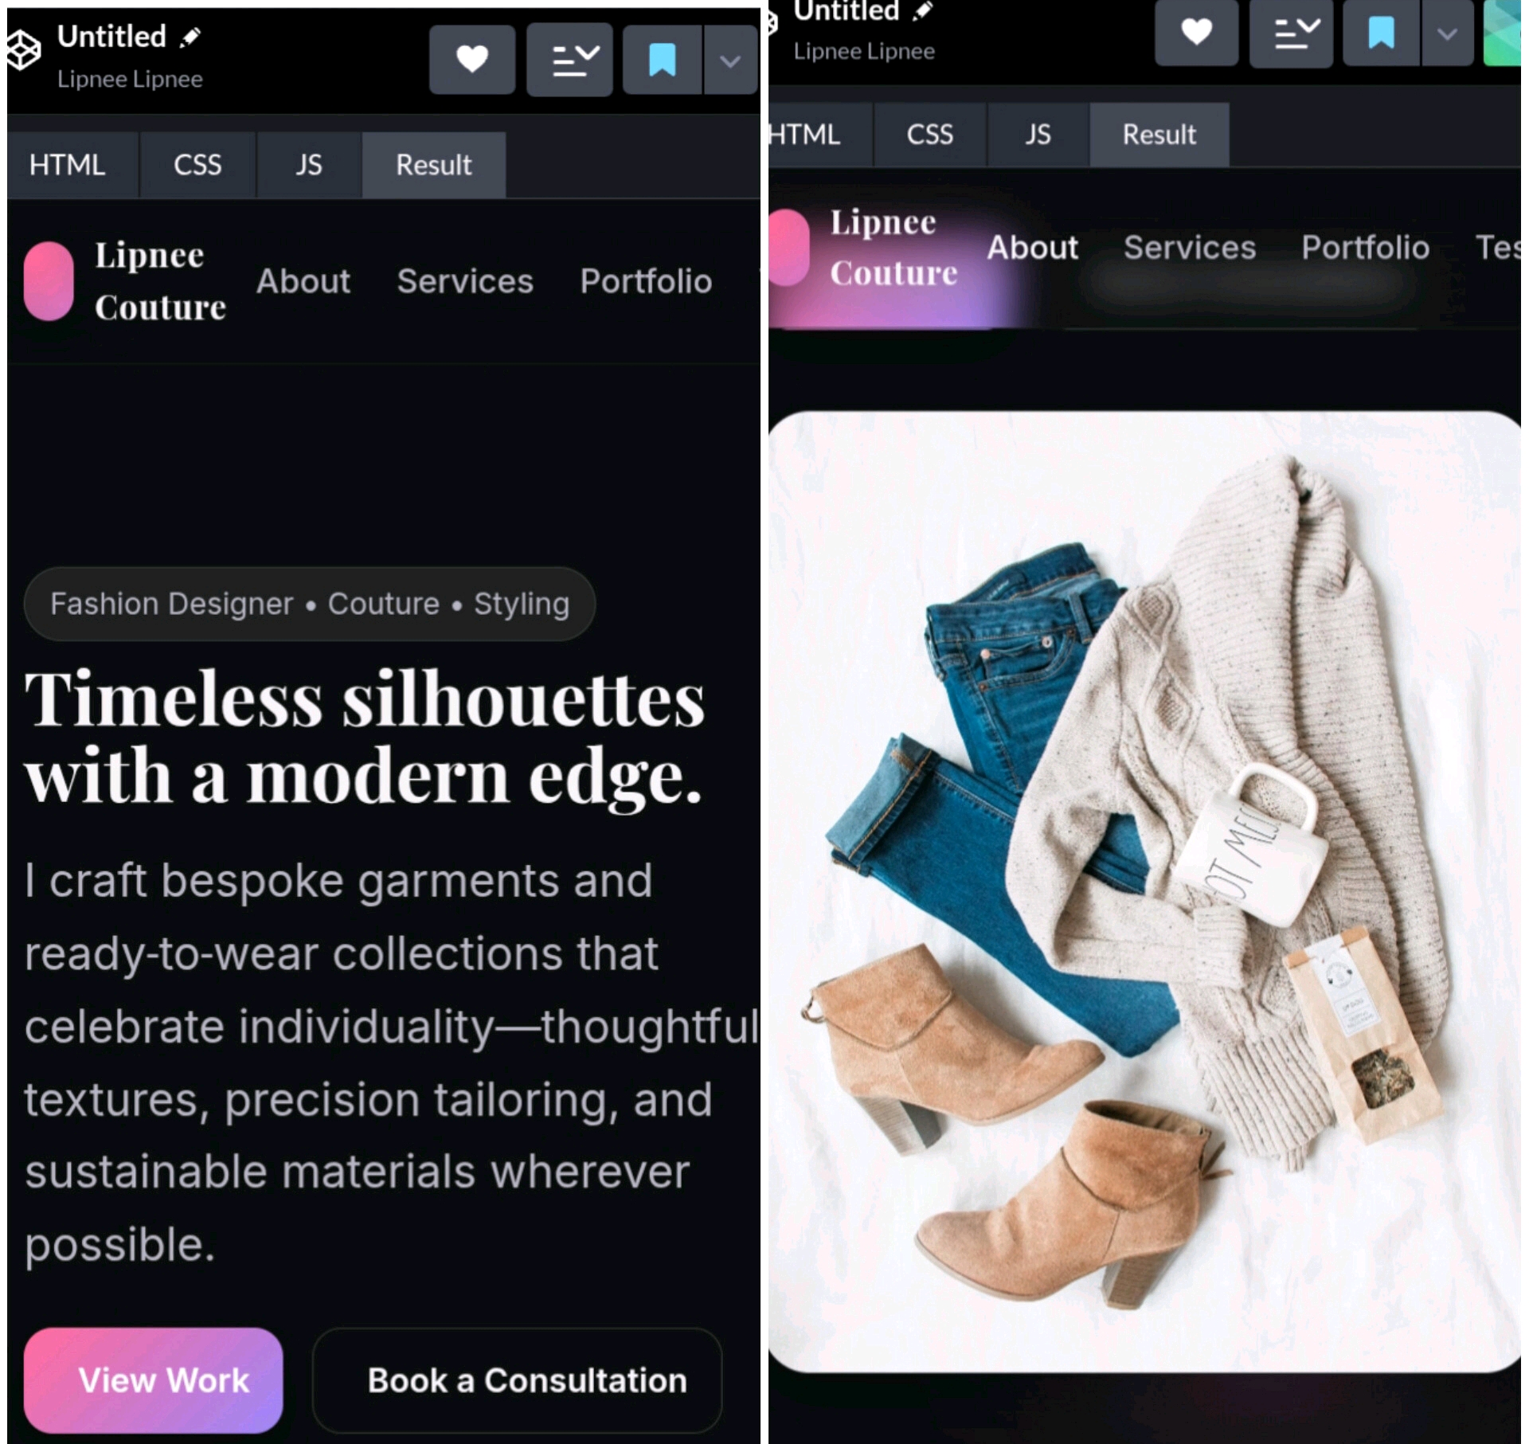

RESULTS AND SCREENSHOTS
3/21/2024 Annual Review
10

Slide 11
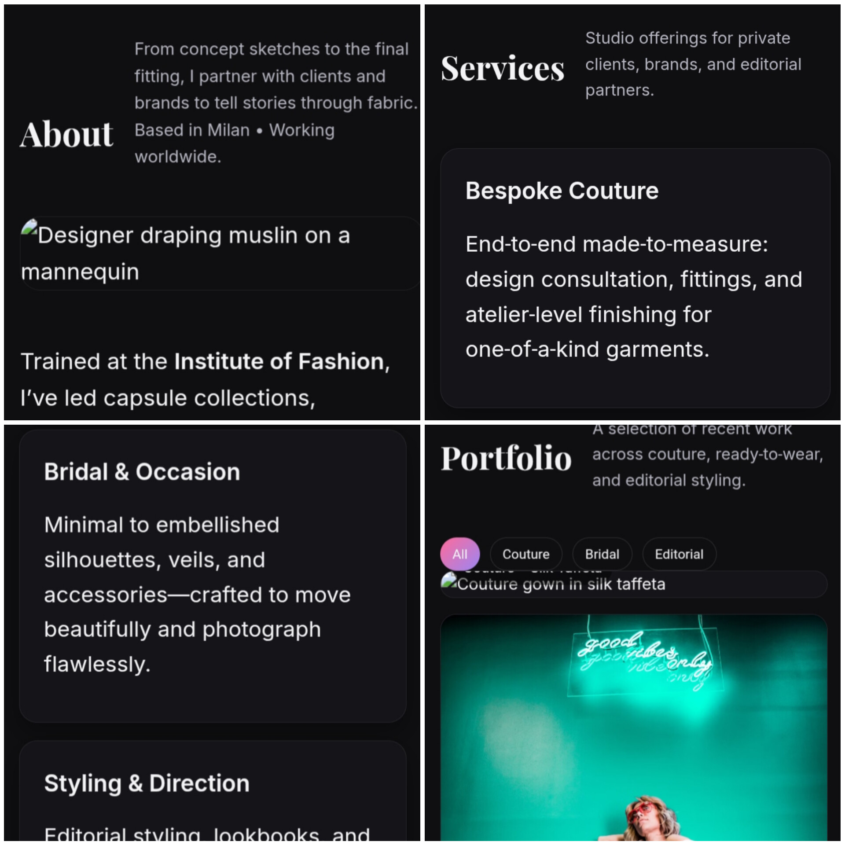

Slide 12
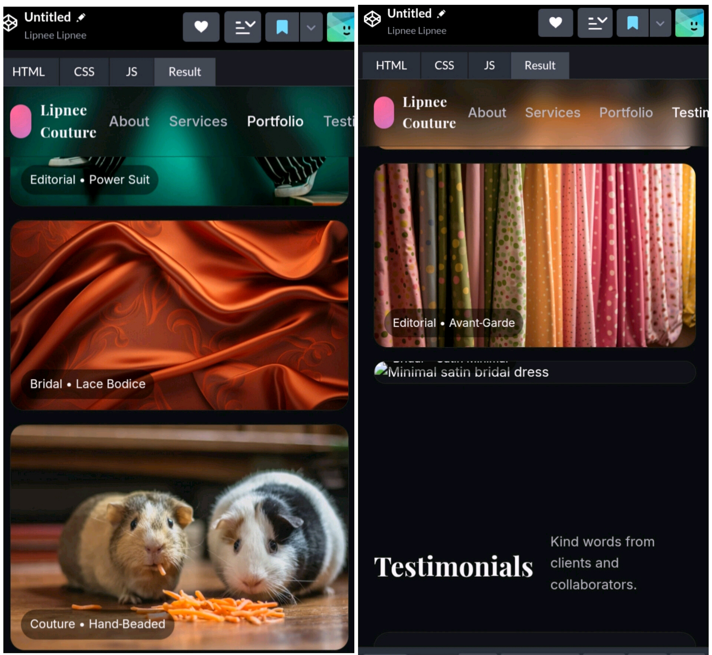

Slide 13
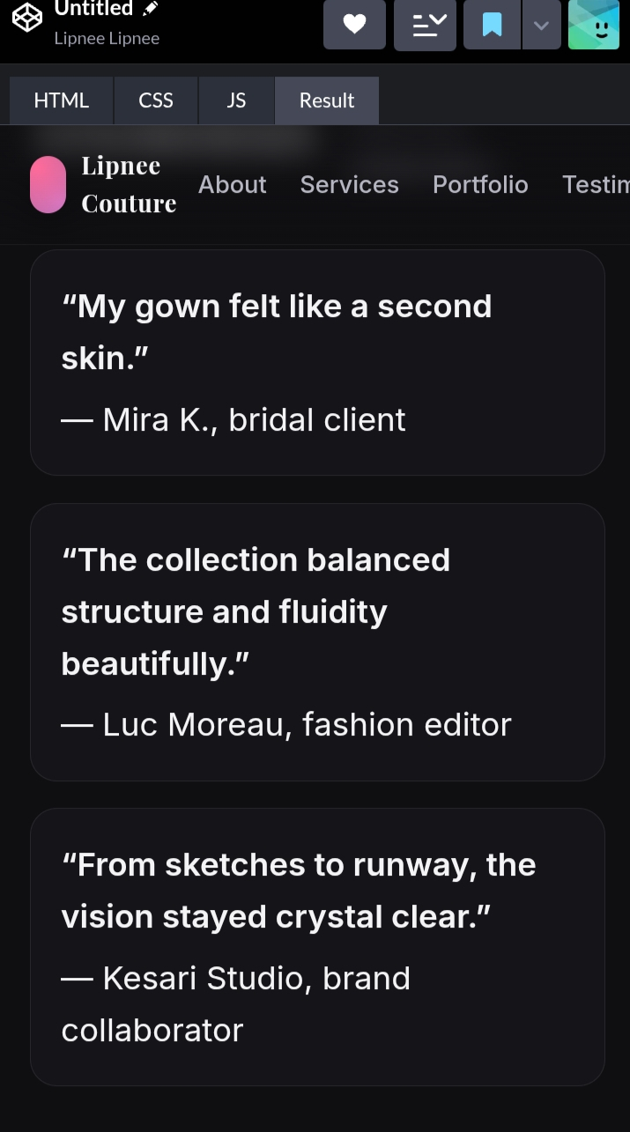

Slide 14
CONCLUSION
Fabric plays a foundational role in the design, function, and sustainability of garments and products. From natural to synthetic fibers, each fabric offers unique characteristics in terms of texture, durability, comfort, and performance. As innovation in textile technology grows, functionality such as moisture-wicking, UV protection, stretchability, and eco-friendliness becomes increasingly essential. A well-curated fabric portfolio enables designers and manufacturers to choose materials best suited for specific uses, balancing aesthetic appeal with functional requirements and environmental impact.
14

